Slide 1
MATHEMATICAL FOUNDATION FOR COMPUTER SCIENCE
Prepared by: Er. Ankit Kharel
Nepal college of information technology

Slide 2
Finite state automata
• Sequential Circuits and Finite state Machine
• Finite State Automata
• Non-deterministic Finite State Automata
• Language and Grammars
• Language and Automata
• Regular Expression

Slide 3

Finite state machine(FSM):
Finite State Machine
Finite State Machine
With output
Finite State Machine
Without output
Mealy
Moore
DFA
$∋−$NFA
NFA

Slide 4
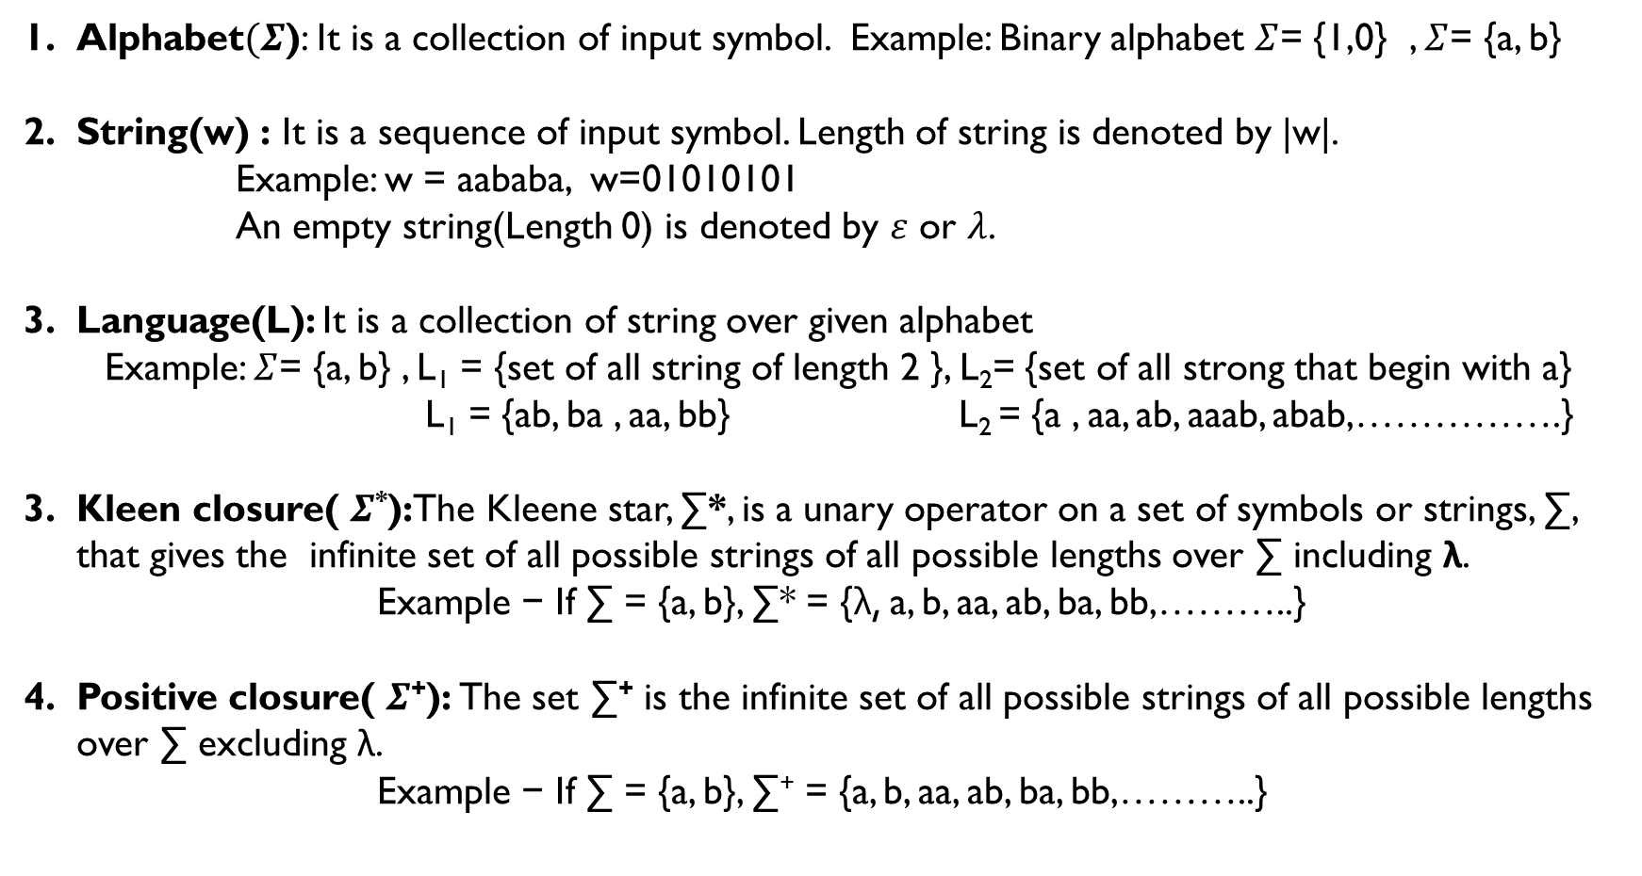
Few Terminologies:
Alphabet$(Σ$): It is a collection of input symbol. Example: Binary alphabet $Σ$= {1,0} , $Σ$= {a, b}
String(w) : It is a sequence of input symbol. Length of string is denoted by |w|.
Example: w = aababa, w=01010101
An empty string(Length 0) is denoted by $ε$ or $λ$.
Language(L): It is a collection of string over given alphabet
Example: $Σ$= {a, b} , L₁ = {set of all string of length 2 }, L₂= {set of all strong that begin with a}
L₁ = {ab, ba , aa, bb} L₂ = {a , aa, ab, aaab, abab,…………….}
Kleen closure( $Σ$*):The Kleene star, ∑*, is a unary operator on a set of symbols or strings, ∑, that gives the infinite set of all possible strings of all possible lengths over ∑ including λ.
Example − If ∑ = {a, b}, ∑* = {λ, a, b, aa, ab, ba, bb,………..}
Positive closure( $Σ$⁺): The set ∑⁺ is the infinite set of all possible strings of all possible lengths over ∑ excluding λ.
Example − If ∑ = {a, b}, ∑⁺ = {a, b, aa, ab, ba, bb,………..}

Slide 5
Deterministic Finite state Automata(DFA):
DFA is a Finite State Machine that accepts or rejects a given string of symbols, by running through a state sequence uniquely determined by the string. Deterministic refers to the uniqueness of the computation run.
Formal Definition of Deterministic Finite State Automata(DFA)
A deterministic finite state automata is defined as
M = (I, S, f, σ, A)
(a) I = A finite set of input symbols.
(c) S = A finite set of states.
(d) f =A next-state Transition function defines as S × I into S.
(e) σ =An initial state σ ∈ S.
(f) A = set of accepting state or final state

Slide 6
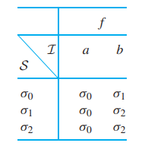
Deterministic Finite state Automata(DFA):
The transition diagram of the finite-state automaton A = (I, S, f, A, σ), where
I = {a, b}, S = {σ0, σ1, σ2}, A = {σ2}, σ = σ0, and f is given by the following table
b
b
b
σ2
σ0
σ1
a
a
a
Is the string “abaa” accepted by the finite-state automaton?

Slide 7
Acceptance by dfa:
Let A = (I, S, f, A, σ) be a finite-state automaton.
Let w = x₁ ··· x_{n} be a string over I. If there exist states σ₀,..., σ_{n} satisfying
(a) σ₀ = σ
(b) f(σ_{i}−1, x_{i}) = σ_{i} for i = 1,..., n
(c) σ_{n} ∈ A,
we say that w is accepted by A. The null string is accepted if and only if σ ∈ A.
Is the string “abaa” accepted by the finite-state automaton?
b
b
a
S\I | input | Next state
σ0 | a | σ0
σ0 | b | σ1
σ1 | a | σ0
σ0 | a | σ0
b
σ0
σ1
σ2
a
a
Since, σ0 is not the final state the string is not accepted

Slide 8
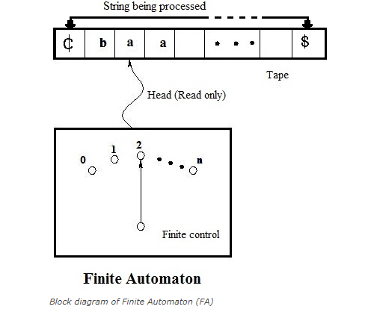
Processing of string by dfa:
The thought process of a finite automaton can be graphically represented as;

Slide 9
Processing of string by dfa:
The various components consist by a finite automata is as follows;
a) Input tape: The input tape has the left end and extends to the right end. It is divided into squares and each square containing a single symbol from the input alphabet ∑. The end squares of the tape contain the end markers ₵ at the left end and the end marker $ at the right end. The absence of endmarkers indicates that the tape is of infinite length.
b) Read only Head: The tape has a read only head that examines only one square at a time and can move one square either to the left or to the right. At the beginning of the operation the head is always at the leftmost square of the input tape. For further analysis, machine restrict the moment of the read only head from left to right direction only and one square every time when it reads a symbols.
c) Finite control: There is a finite control which determines the state of the automaton and also controls the movement of the head. The input to the finite control will usually be the symbol under the read head (assumed a) and the present state of the machine (assumed q) to give the following outputs;
A motion of Read head along the tape to the next square.
The next state of the finite state machine given by δ(q, a)

Slide 10
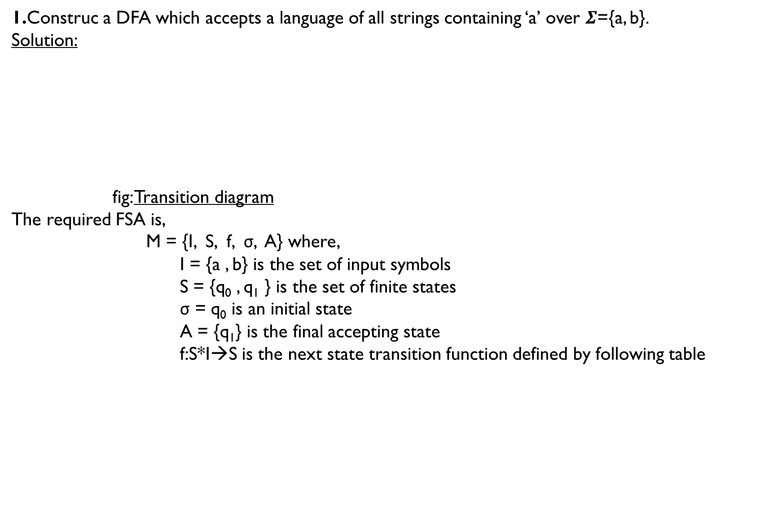
1.Construc a DFA which accepts a language of all strings containing ‘a’ over $Σ$={a, b}.
Solution:
fig: Transition diagram
The required FSA is,
M = {I, S, f, σ, A} where,
I = {a , b} is the set of input symbols
S = {q₀ , q₁ } is the set of finite states
σ = q₀ is an initial state
A = {q₁} is the final accepting state
f:S*I→S is the next state transition function defined by following table
b
a
q₀
a
q₁
b
S I | a | b
q₀ | q₁ | q₀
q₁ | q₁ | q₁

Slide 11
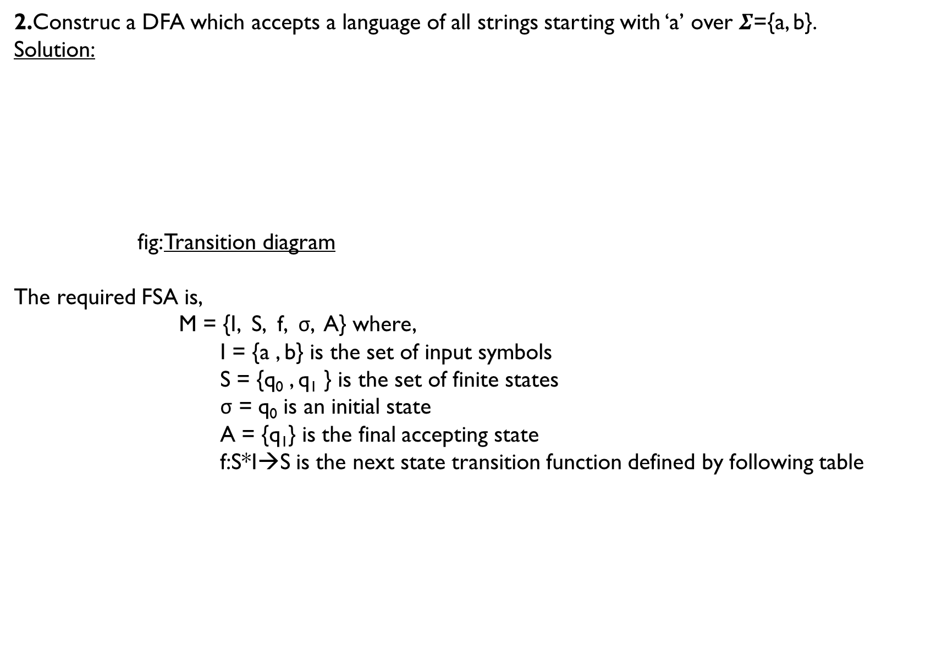
2.Construc a DFA which accepts a language of all strings starting with ‘a’ over $Σ$={a, b}.
Solution:
fig: Transition diagram
The required FSA is,
M = {I, S, f, σ, A} where,
I = {a , b} is the set of input symbols
S = {q₀ , q₁ } is the set of finite states
σ = q₀ is an initial state
A = {q₁} is the final accepting state
f:S*I→S is the next state transition function defined by following table
b
q₀
a
q₁
a
b
q₃
S I | a | b
q₀ | q₁ | q₃
q₁ | q₁ | q₁

Slide 12

3.Construc a DFA which accepts a language of all strings containing odd number of ‘a’ over $Σ$={a, b}.
Solution:
fig: Transition diagram
The required FSA is,
M = {I, S, f, σ, A} where,
I = {a , b} is the set of input symbols
S = {q₀ , q₁ } is the set of finite states
σ = q₀ is an initial state
A = {q₁} is the final accepting state
f:S*I→S is the next state transition function defined by following table
b
b
q₀
a
q₁
a
S I | a | b
q₀ | q₁ | q₀
q₁ | q₀ | q₁

Slide 13

4.Construc a DFA which accepts a language of all strings containing substring ‘abaab’ over $Σ$={a, b}.
Solution:
fig: Transition diagram
The required FSA is,
M = {I, S, f, σ, A} where,
I = {a , b} is the set of input symbols
S = {q₀ , q₁ , q₂ , q₃ , q₄ , q₅ } is the set of finite states
σ = q₀ is an initial state
A = {q₅} is the final accepting state
f:S*I→S is the next state transition function
defined by following table
a
b
b
a
a , b
q₀
a
b
q₂
a
q₃
a
q₄
b
q₅
q₁
b
S I | a | b
q₀ | q₁ | q₀
q₁ | q₁ | q₂
q₂ | q₃ | q₀
q₃ | q₄ | q₂
q₄ | q₁ | q₅
q₅ | q₅ | q₅

Slide 14

5.Construc a DFA which accepts a language of all strings that does not contain substring ‘aabb’ over $Σ$={a, b}.
Solution:
First construct the DFA that accepts string containing substring “aabb”:
Now, Flip the final and non final state:
b
a
a , b
q₀
a
a
q₂
b
q₃
b
q₁
q₄
b
a
b
a
a , b
q₀
a
a
q₂
b
q₃
b
q₁
q₄
b
a

Slide 15
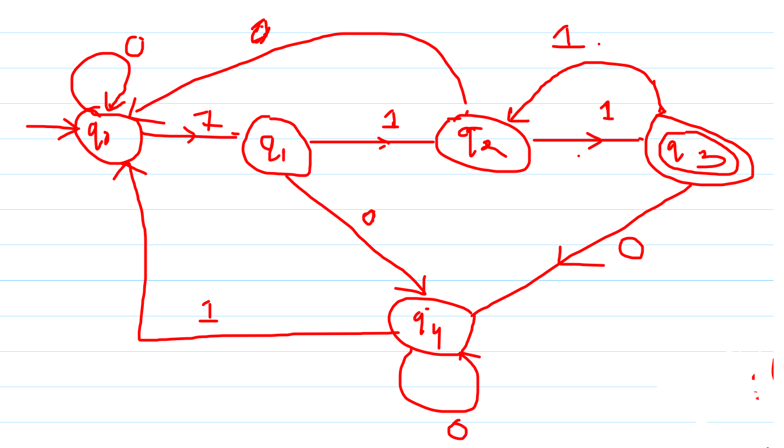
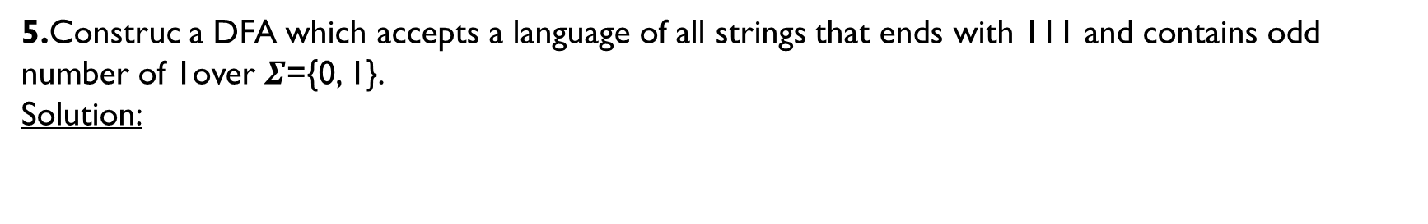
5.Construc a DFA which accepts a language of all strings that ends with 111 and contains odd number of 1over $Σ$={0, 1}.
Solution:

